Slide 1

ANALYSSING HOUSING PRICES IN METROPOLITIAN AREAS OF INDIA
Team members
meenakshi.s
Monika sri.c
Mohana Lakshmi.s
Mownithambal.

Slide 2
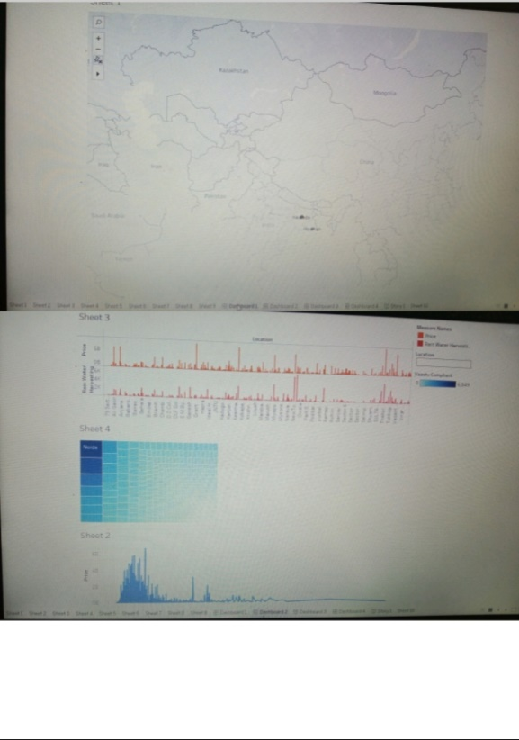
Dashboard

Slide 3
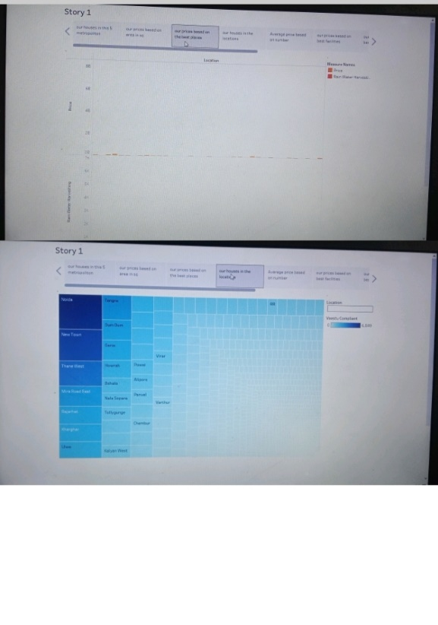
Dashboard

Slide 4
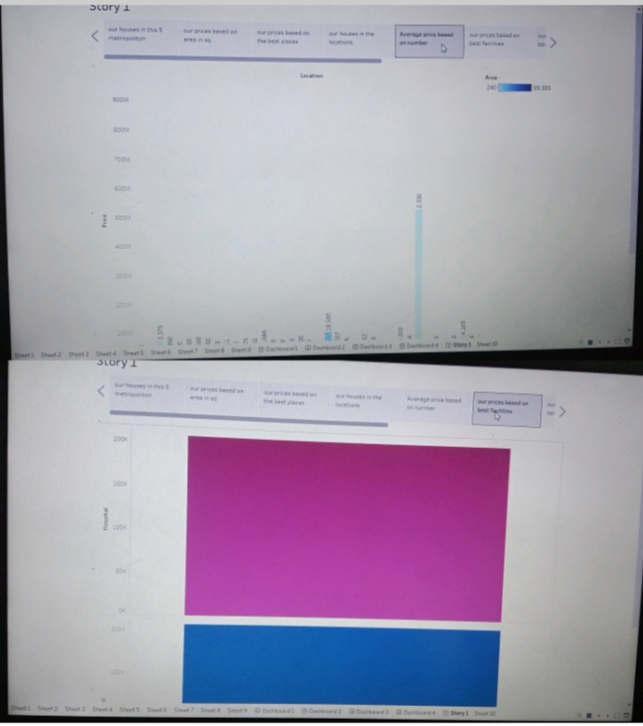
Story

Slide 5
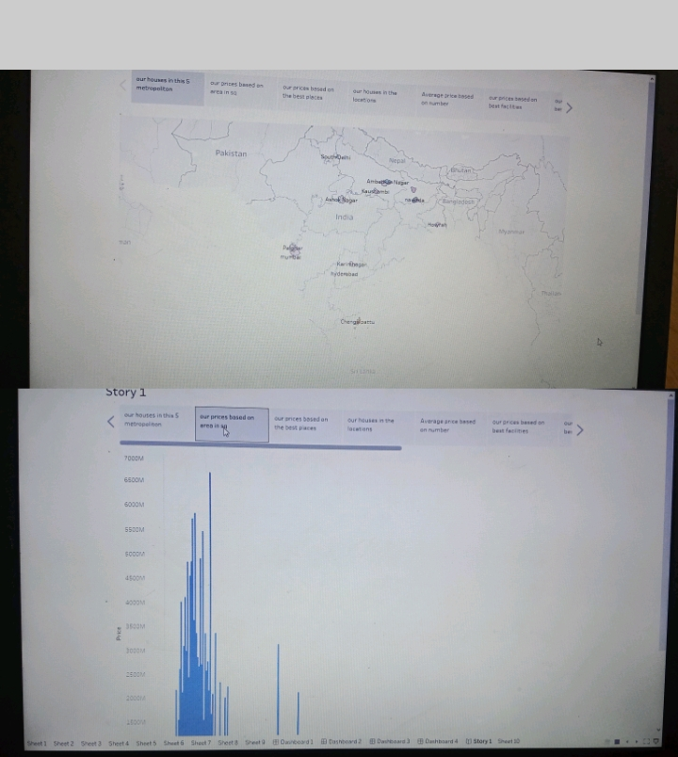
Story

